Slide 1

Spring 2022
Hypothesis testing
& p-values
Programming and Data Analysis for Modern Neuroscience
NEU 365P/385L
Marcel Goldschen-ohm
Assistant Professor in the Department of Neuroscience, The University of Texas at Austin

Slide 2
Disclaimer
Several slides were adapted with permission from a presentation by Shai D. Silberberg from the National Institute of Neurological Disorders and Stroke.

Slide 3

Learning goals – p-values
You will understand what a p-value is.
You will understand how to perform a hypothesis test.
You will understand common misinterpretations of p-values.
You will understand that it is wise to consider a significant p-value as grounds to follow up on that observation rather than strong evidence for an effect.
You will understand that a significant p-value does not imply a large effect.

Slide 4
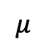
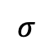
Population vs. Sample Distribution
$$μ$$
Species
$$σ$$
life expectancy

Slide 5

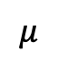
Population vs. Sample Distribution
$$μ$$
Species
$$σ$$
life expectancy
$$μ$$
Sample of $n$ individuals
mean life expectancy

Slide 6
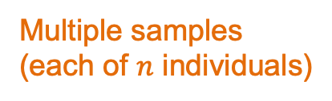
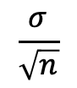
Population vs. Sample Distribution
$$μ$$
Species
$$σ$$
life expectancy
$$μ$$
$$\frac{σ}{\sqrt{n}}$$
Multiple samples
(each of $n$ individuals)
mean life expectancy

Slide 7
Central Limit Theorem
$$μ$$
Species
$$σ$$
life expectancy
$$μ$$
Expected by CLT
$$\frac{σ}{\sqrt{n}}$$
Multiple samples
(each of $n$ individuals)
mean life expectancy

Slide 8
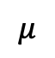
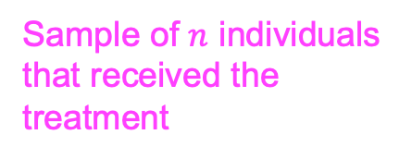
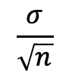
Does an experimental treatment affect life expectancy?
$$μ$$
Expected for normal individuals
Sample of $n$ individuals that received the treatment
$$\frac{σ}{\sqrt{n}}$$
mean life expectancy
Yes? No? Maybe?

Slide 9
Does an experimental treatment affect life expectancy?
$$μ$$
Expected for normal individuals
Sample of $n$ individuals that received the treatment
$$\frac{σ}{\sqrt{n}}$$
mean life expectancy
Yes? No? Maybe?

Slide 10
Does an experimental treatment affect life expectancy?
$$μ$$
Expected for normal individuals
Sample of $n$ individuals that received the treatment
$$\frac{σ}{\sqrt{n}}$$
mean life expectancy
Yes? No? Maybe?

Slide 11

Null Hypothesis ($H_{0}$): Treatment has no effect on life expectancy
$$μ$$
Expected for normal individuals
Sample of $n$ individuals that received the treatment
$$\frac{σ}{\sqrt{n}}$$
mean life expectancy
Start by assuming that $H_{0}$is true. i.e., the mean life expectancy of the treatment group is explained purely by random variation.

Slide 12
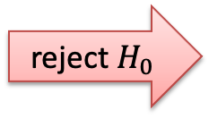
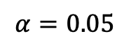

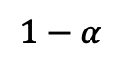
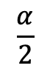
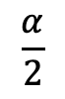
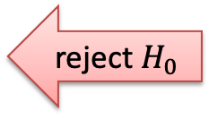
Decide whether to reject the null hypothesis
$$α=0.05$$
$$1−α$$
$$\frac{α}{2}$$
$$\frac{α}{2}$$
mean life expectancy
reject $H_{0}$
do not reject $H_{0}$
reject $H_{0}$

Slide 13
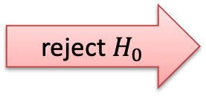

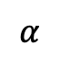
Single-tailed decision boundary
$$α=0.05$$
$$1−α$$
$$α$$
mean life expectancy
do not reject $H_{0}$
reject $H_{0}$

Slide 14
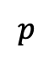
p-value
p-value: Probability of observing a value as extreme or more extreme assuming the null hypothesis is true.
$$p$$
mean life expectancy
reject $H_{0}$
do not reject $H_{0}$
reject $H_{0}$

Slide 15
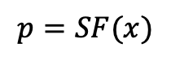
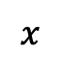
Get a p-value from a probability distribution
$$x$$
$$p=SF(x)$$
mean life expectancy

Slide 16
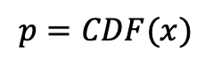
Get a p-value from a probability distribution
$$x$$
$$p=CDF(x)$$
mean life expectancy

Slide 17
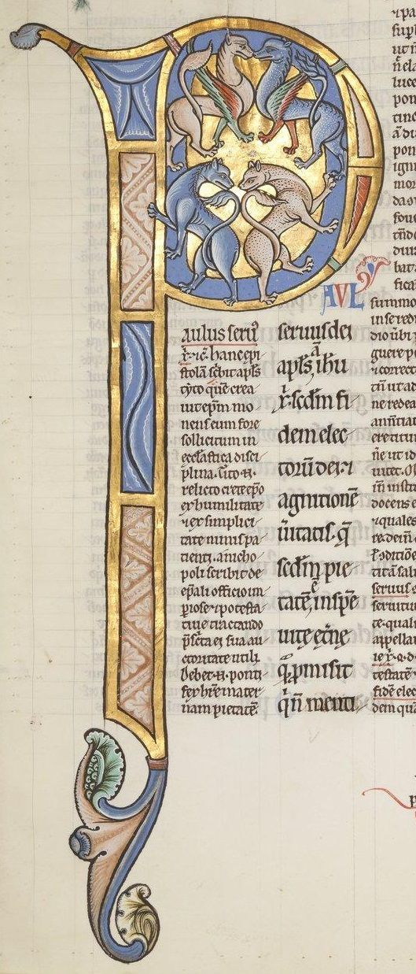
p-value
“The P value is a measure of statistical evidence that appears in virtually all medical research papers. Its interpretation is made extraordinarily difficult because it is not part of any formal system of statistical inference.
As a result, the P value’s inferential meaning is widely and often wildly misconstrued, a fact that has been pointed out in innumerable papers and books appearing since at least the 1940s.”
Steven Goodman. 2008. Semin Hematol 45:135-140

Slide 18
Logical
If the [null] hypothesis is correct, then this result can’t occur.
It has, however, occurred.
Therefore, the [null] hypothesis is false.
Pollard, P. and Richardson, J. T. E. 1987. Psychol. Bull. 102: 159-163

Slide 19
Seems logical at first glance
If the [null] hypothesis is true, then this result would probably not occur.
This result has occurred.
Then the [null] hypothesis is probably not true.
Pollard, P. and Richardson, J. T. E. 1987. Psychol. Bull. 102: 159-163

Slide 20
But can get you in trouble!
If a person is an American, then the person is probably not a member of Congress.
This person is a member of Congress.
Therefore, the person is probably not an American.
Pollard, P. and Richardson, J. T. E. 1987. Psychol. Bull. 102: 159-163

Slide 21
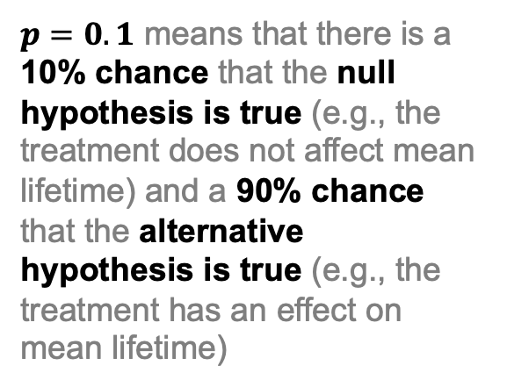
p-value common misconceptions
$p=0.1$ means that there is a 10% chance that the null hypothesis is true (e.g., the treatment does not affect mean lifetime) and a 90% chance that the alternative hypothesis is true (e.g., the treatment has an effect on mean lifetime)

Slide 22
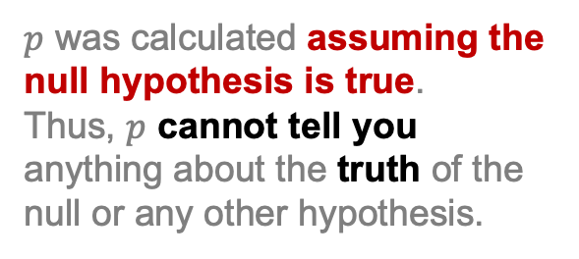
p-values don’t tell you anything about the truth of a hypothesis
$p=0.1$ means that there is a 10% chance that the null hypothesis is true (e.g., the treatment does not affect mean lifetime) and a 90% chance that the alternative hypothesis is true (e.g., the treatment has an effect on mean lifetime)
$p$ was calculated assuming the null hypothesis is true.
Thus, $p$ cannot tell you anything about the truth of the null or any other hypothesis.

Slide 23
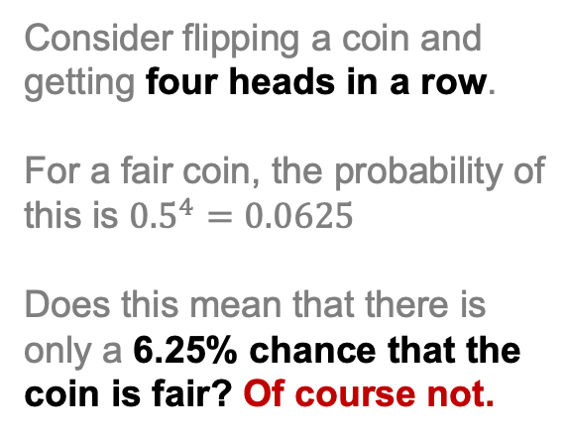
p-values don’t tell you anything about the truth of a hypothesis
$p=0.1$ means that there is a 10% chance that the null hypothesis is true (e.g., the treatment does not affect mean lifetime) and a 90% chance that the alternative hypothesis is true (e.g., the treatment has an effect on mean lifetime)
Consider flipping a coin and getting four heads in a row.
For a fair coin, the probability of this is ${0.5}^{4}=0.0625$
Does this mean that there is only a 6.25% chance that the coin is fair? Of course not.

Slide 24
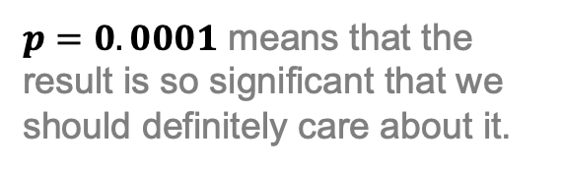
p-value vs. effect size
$p=0.0001$ means that the result is so significant that we should definitely care about it.

Slide 25
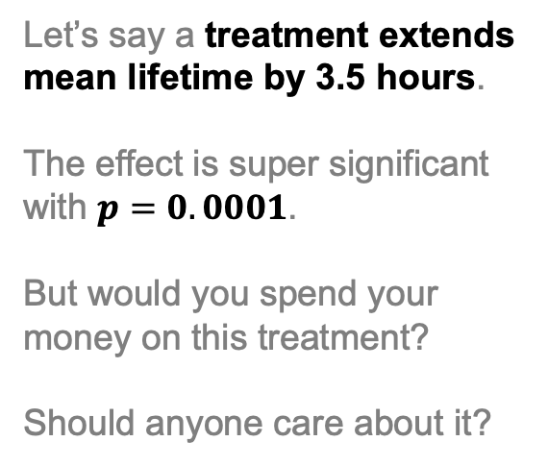
p-value vs. effect size
$p=0.0001$ means that the result is so significant that we should definitely care about it.
Let’s say a treatment extends mean lifetime by 3.5 hours.
The effect is super significant with $p=0.0001$.
But would you spend your money on this treatment?
Should anyone care about it?

Slide 26
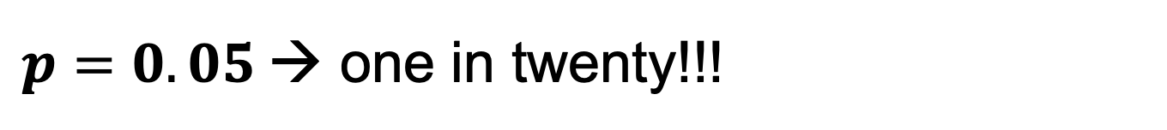
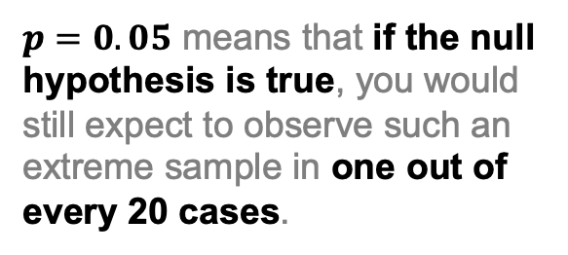
$p=0.05$→ one in twenty!!!
$p=0.05$ means that if the null hypothesis is true, you would still expect to observe such an extreme sample in one out of every 20 cases.

Slide 27
Publication bias
$p=0.05$ means that if the null hypothesis is true, you would still expect to observe such an extreme sample in one out of every 20 cases.
If 20 labs all perform the same experiment, one of the labs is likely to “discover” a significant effect even though there is none.
This lab publishes their amazing discovery, whereas the other 19 labs DO NOT publish their disappointing results.

Slide 28
Multiple features
$p=0.05$ means that if the null hypothesis is true, you would still expect to observe such an extreme sample in one out of every 20 cases.
If your data includes measures for 20 different features, you will likely “discover” a significant effect for one of the features even though there is none.

Slide 29
p-hacking
$p=0.05$ means that if the null hypothesis is true, you would still expect to observe such an extreme sample in one out of every 20 cases.
If your data includes measures for 20 different features, you will likely “discover” a significant effect for one of the features even though there is none.
Just keep collecting data until you find a feature with the p-value you want!

Slide 30
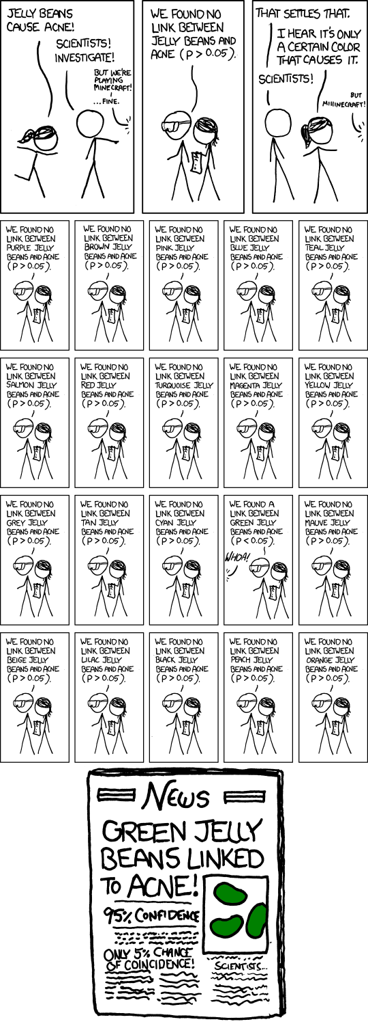
p-hacking
Adapted from http://xkcd.com/882/

Slide 31
p-hacking
Any size effect can become significant with a large enough sample size.
Just keep collecting data until you get the p-value you want!
Increasing sample size
Krzywinski, M. and Altman, N. 2013. Nature Methods 10:1139-1140

Slide 32
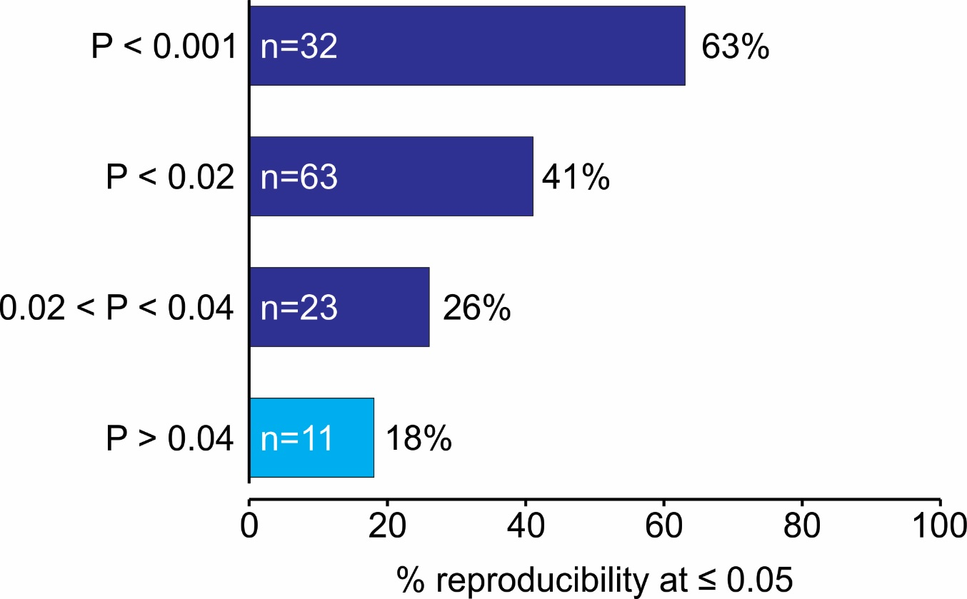
Reproducibility in psychological science inversely related to p-value
The Open Science Collaboration. 2015. Science
DOI: 10.1126/science.aac4716

Slide 33
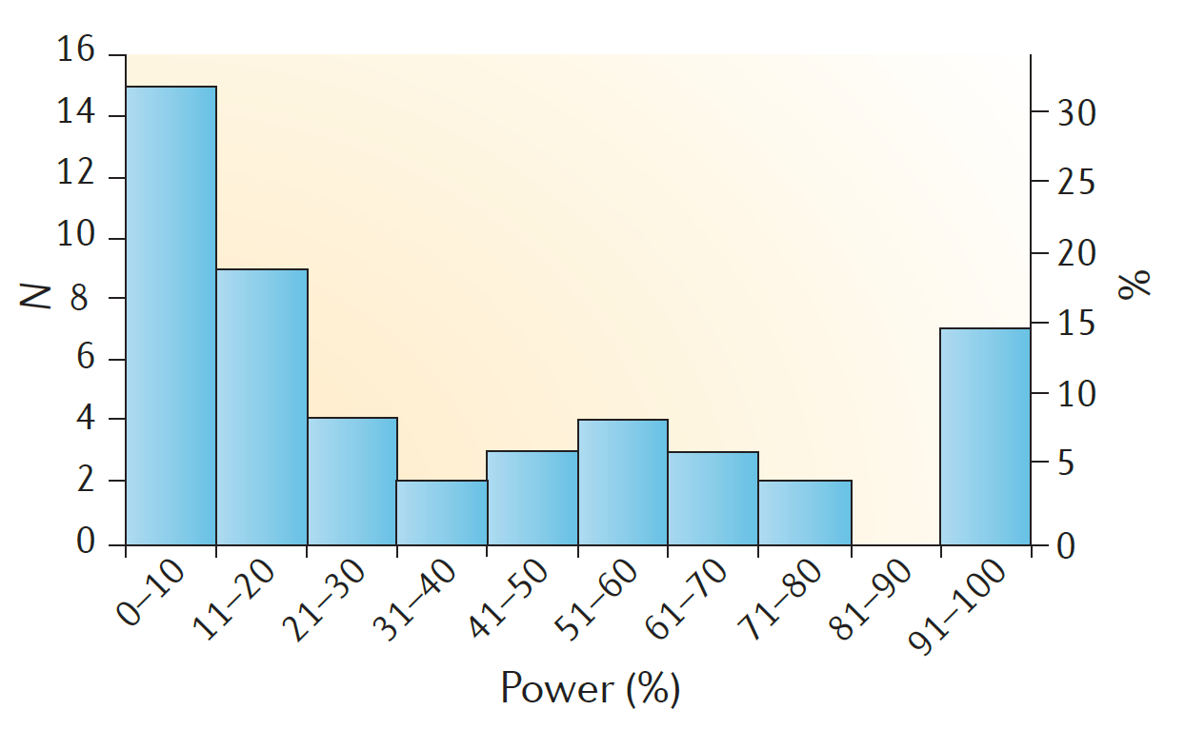
Low statistical power in biomedical science
“We optimistically estimate the median statistical power of studies in the neuroscience field to be between ~8% and ~31%”
Button et al. 2013. Nat Rev Neurosci. 14: 365-376

Slide 34

p-values are known to be problematic
“My conclusion is that we must abandon the statistical significance test”
Schmidt, 1996
“The most important task before us in developing statistical science is to demolish the P-value culture”
Nelder, 1999
Scientists rise up against statistical significance
More than 800 signatories call for an end to hyped claims and the dismissal of possibly crucial effects.
Nature: 21 March 2019
“Although I applaud the motivation of attempts to eliminate P-values, they have failed in the past and I predict that they will continue to fail.”
Goodman, 2001

Slide 35
p-value misinformation is everywhere
!!! WARNING !!!
Many p-value YouTube tutorials fall prey to these misconceptions.

Slide 36
p-value origins
“The value for which P = 0.05, or 1 in 20, …
… it is convenient to take this point as a limit in judging whether a deviation is to be considered significant or not.
Using this criterion, we should be led to follow up a false indication only once in 20 trials, even if the statistics were the only guide available.”
Ronald Fisher
Fisher R. A. 1934. Statistical Methods for Research Workers (P. 45)

Slide 37
p-value origins
“If we accept this convenient convention [of statistical significance], … we thereby admit that no isolated experiment, however significant in itself, can suffice for the experimental demonstration of any natural phenomenon; for the ‘one chance in a million’ will undoubtedly occur, with no less and no more than its appropriate frequency, however surprised we may be that it should occur to us.”
The Design of Experiments (1935)
Ronald Fisher

Slide 38

p-values can easily fool you
You make a fool of yourself if you declare that you have discovered something, when all you are observing is random chance.
From this point of view, what matters is the probability that, when you find that a result is ‘statistically significant’, there is actually a real effect.
David Colquhoun
R. Soc. Open sci. 1: 140216.

Slide 39
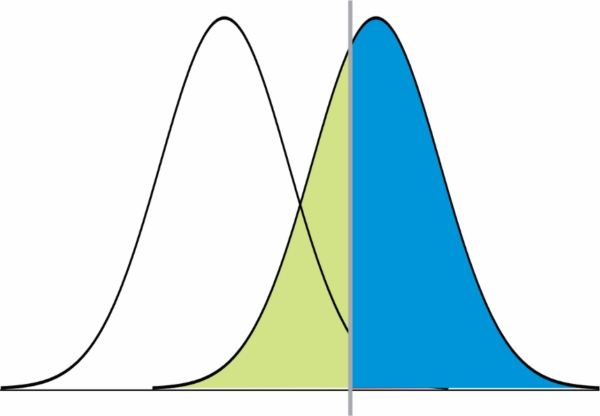
What you really want are the sampling distributions for both control and test conditions
control
test
1-β (“power”)
Power is the probability that a test sample correctly rejects the null hypothesis when the alternative hypothesis is true.

Slide 40

Take p-values with a grain of salt
In isolation, p-values are
not strong evidence of anything.
Focus on large effects.

Slide 41
Learning goals – p-values
You will understand what a p-value is.
You will understand how to perform a hypothesis test.
You will understand common misinterpretations of p-values.
You will understand that it is wise to consider a significant p-value as grounds to follow up on that observation rather than strong evidence for an effect.
You will understand that a significant p-value does not imply a large effect.

